Slide 1
RAD Fair Housing, Civil Rights and Relocation Notice:
Live Q&A
December 1, 2016

Slide 2
OVERVIEW
Notice divided into two major parts:
Fair Housing and Civil Rights
    Focus is on providing clarity regarding existing fair housing and civil rights obligations and how they impact RAD transactions
    The requirements are not new
    The PHA remains primarily responsible for civil rights compliance
    Relocation
    Additional resident protections
    Streamlines and facilitates implementation of relocation
    Clarifies relocation requirements
Notes:
While it’s 80 pages, the bulk of it explains how pre-existing requirements apply.

Slide 3
New Requirements and Changes
New Requirements - Process:
    Once PRA is complete, PHAs will be required to use the new Checklist to submit materials
    Changed Requirements - Timing:
    Earlier submission of site selection materials and other front-end civil rights review materials
    Front-end civil rights review approvals required for submission of financing plan (not just required by closing)
    Approval of AFHMP required for marketing, not closing
    Clarity and Transparency – Underlying Policy:
    Explanation of requirements and factors considered
    Description of risk-based analyses used to determine when to review PHA’s activities
    No change in underlying rules or in PHA’s responsibility for civil rights compliance

Slide 4
Summary of Relocation Changes
Defines eligibility for protection more clearly
Specifies what satisfies the right of return
Requires written Relocation Plans for long-term relocation
Adds RAD Information Notice and Notification of Return
Allows earlier relocation after RCC
Requires PHA to maintain resident relocation data
Adds resident protections when PHAs offer residents alternative housing options
Permits use of public housing units for temporary relocation

Slide 5
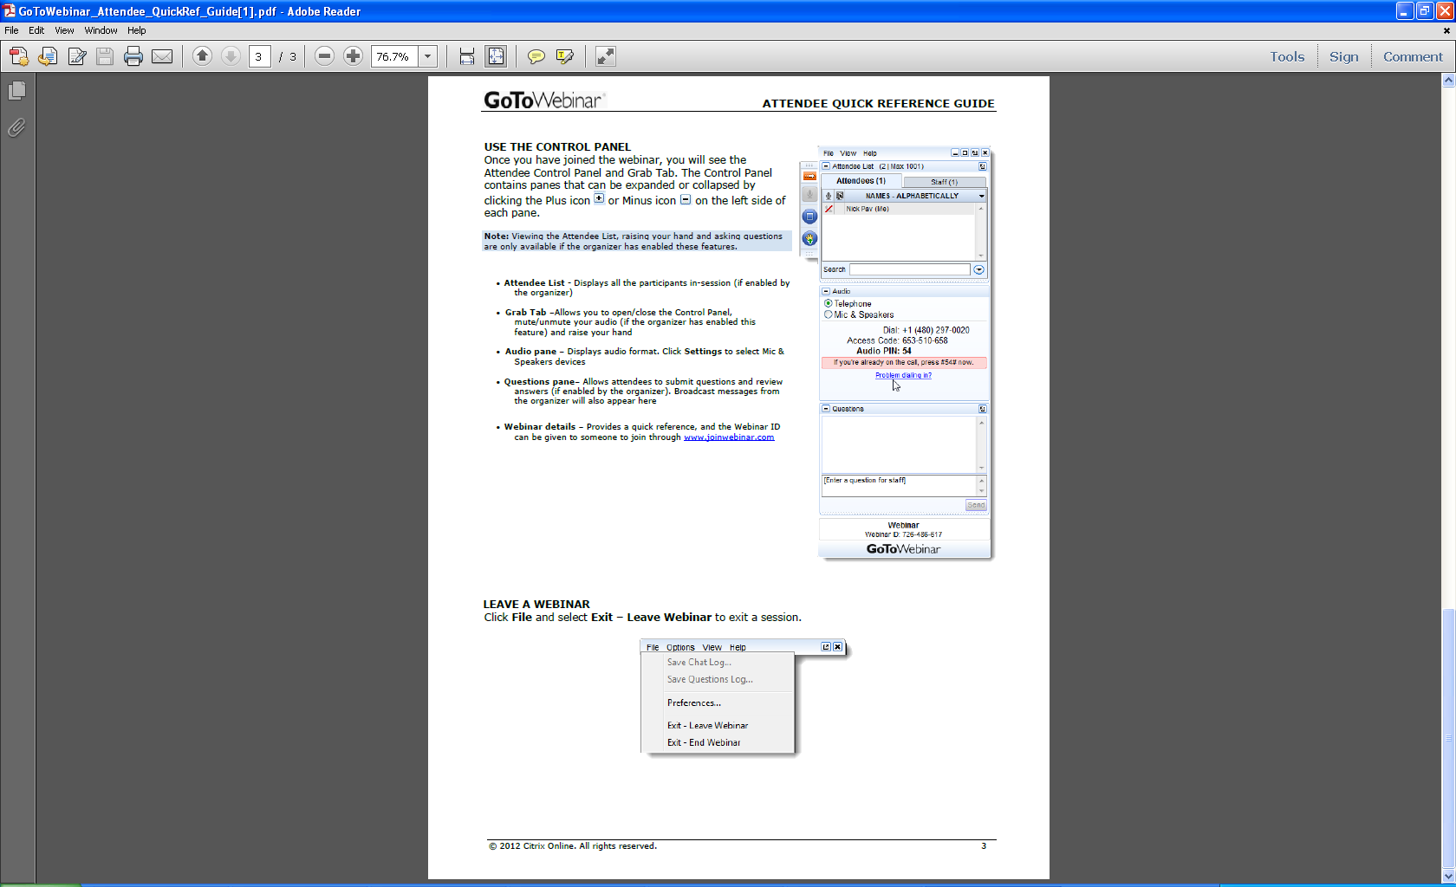
Welcome
Ask questions! Here’s how:
  “Raise your hand” by clicking on the
  hand icon and the presenter will
  un-mute your line so you can ask
  your question live
  Note: To do this, you MUST call the dial-in number shown on your attendee control panel and input the audio PIN shown, which is unique to each attendee
  Send in questions via the “Question” feature

